Slide 1
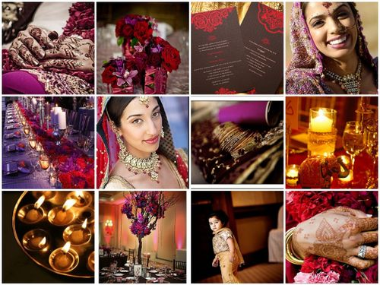
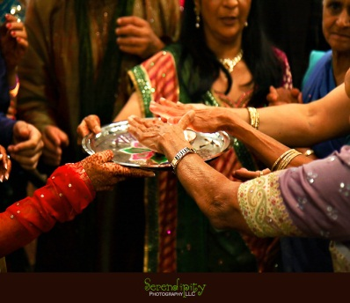
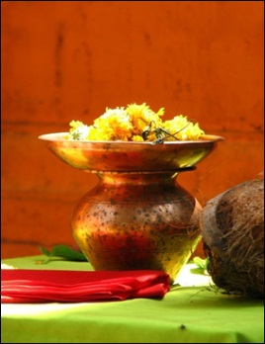
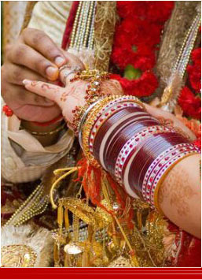
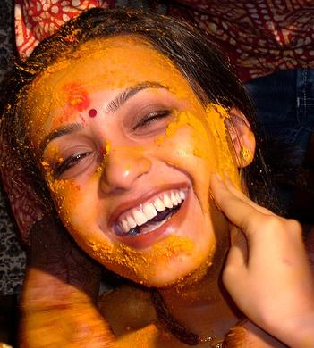
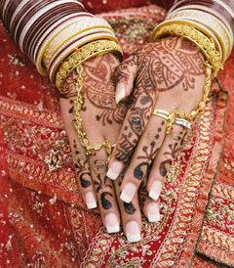
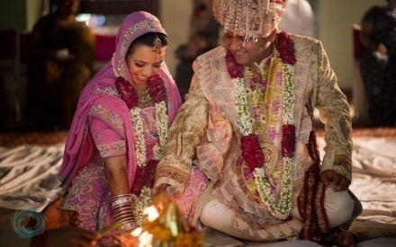
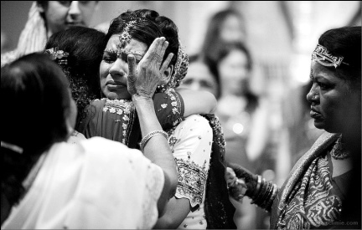
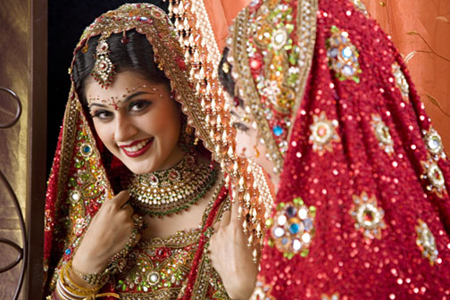
What is Wedding Photography?
Wedding photography is a blend of different types of photography. It is a documentary of the wedding date.

Slide 2
History
1840s - Photography had very little commercial use, but the idea of creating memories of the wedding day was already born.
1950s - Color photographs became possible but photographers continued with black and white films.
1970s - Photographers used their new portable roll film based cameras and compact flashbulb lighting but had low quality.

Slide 3
Current trends
More fashionable approach
Wedding photojournalism
Blend of traditional and journalistic wedding
Half the photo is made on the camera with the half of the photos are achieved through artistic editing and manipulation.

Slide 4


Slide 5
DEPARTMENTS
SALES
CAPTURE
EDITING AND DESIGNING
PRINTING AND DEVELOPING
PURCHASE
ACCOUNTS

Slide 6
SALES DEPARTMENT
Attend client
Get order and deliver it in time
Develop and maintain good relations between client and Studio.
Try to develop Studio’s business.

Slide 7
Packages
Silver – Rs 50,000
One expert wedding photographer.
Number of photographs - around 200.
Printing will be done in studio itself.
Gold – Rs 75,000
Two expert wedding photographers .
Number of photographs - around 500.
Printing and binding will be done at Canvera, Bengaluru.
Platinum – Rs 1,00,000
Expert photographers according to the venue.
Number of photographs - around 750 and storybook album.
Printing and binding will be done at Graphi Studio, Italy.

Slide 8
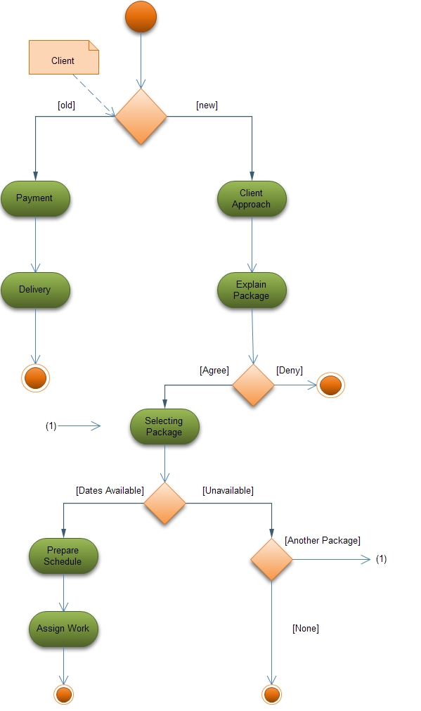
Activity Diagram – Sales Department

Slide 9
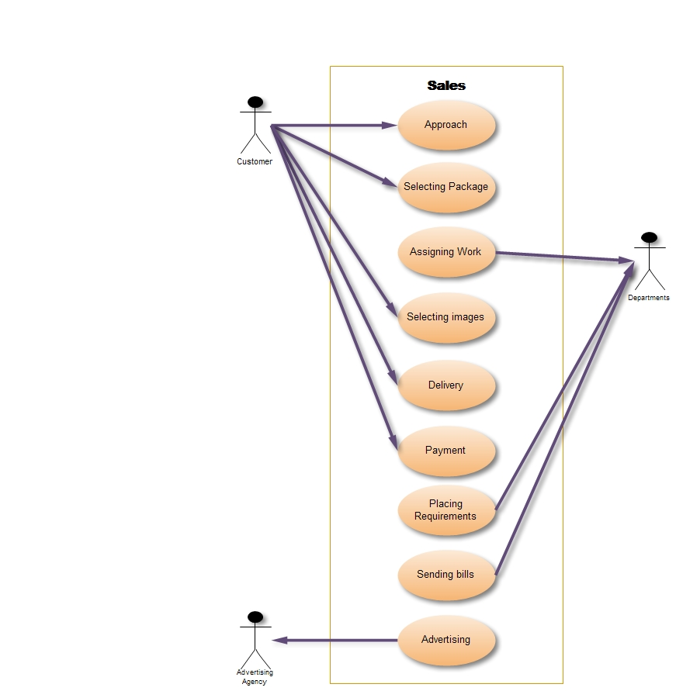
Use Case

Slide 10
Capture Department
Reach at venue little early to setup tools.
Capture/shoot live precious moments.
Select good photographs.

Slide 11
Photo Camera
SLR (Single Lens Reflex): This type of camera is used in low budget events. It contains 35mm Negatives, size of sensor is “APC C” size and around 10mega pixels.
DSLR (Digital Single Lens Reflex): This type of camera is used in High budget events. It captures image digitally, which used CCD (Charge Couple Device).

Slide 12

Video Camera
DV (Digital Video): These Cameras are used for low budget events. It has the resolution size of 720x576 pixels.
HD (High Definition): These Cameras are used for High budget events. It has resolution size of 1280x576/1440x1080 pixels.
HDV (High Definition Video (Full HD)): These Cameras are used for Capturing pictures in 1920x1080 pixels of resolution size.

Slide 13
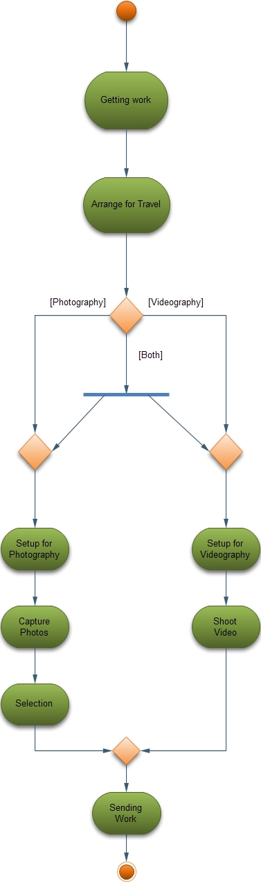
Activity Diagram - Capture Department

Slide 14
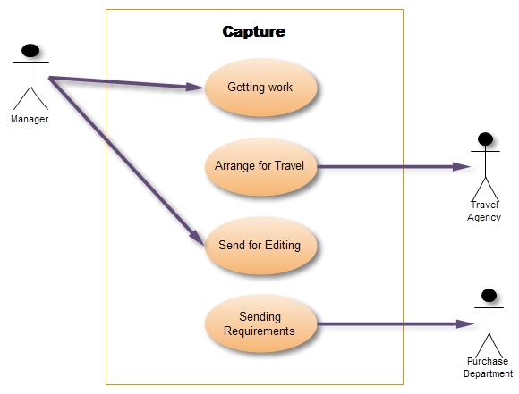
Use case

Slide 15
Editing And Designing Department
Edit the images/video.
Design album.
Prepare final video.
Deliver images/video on time.

Slide 16
Software
Aperture :
For Apple Macintosh Operating System
Basically meant for color correction.
Karizma Classic :
For designing albums
Works fast and saves time for designing.
Adobe Photoshop :
At the Top for photo editing software
Problem : Takes too much time for editing & designing images.

Slide 17
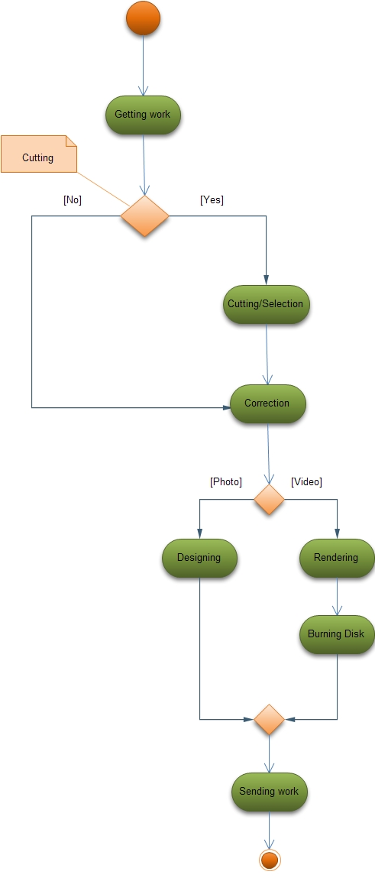
Activity Diagram – Editing And Designing Department

Slide 18
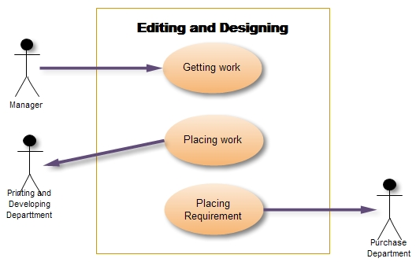
Use case

Slide 19
Developing and Printing Department
Printing images
Sorting images
Binding

Slide 20
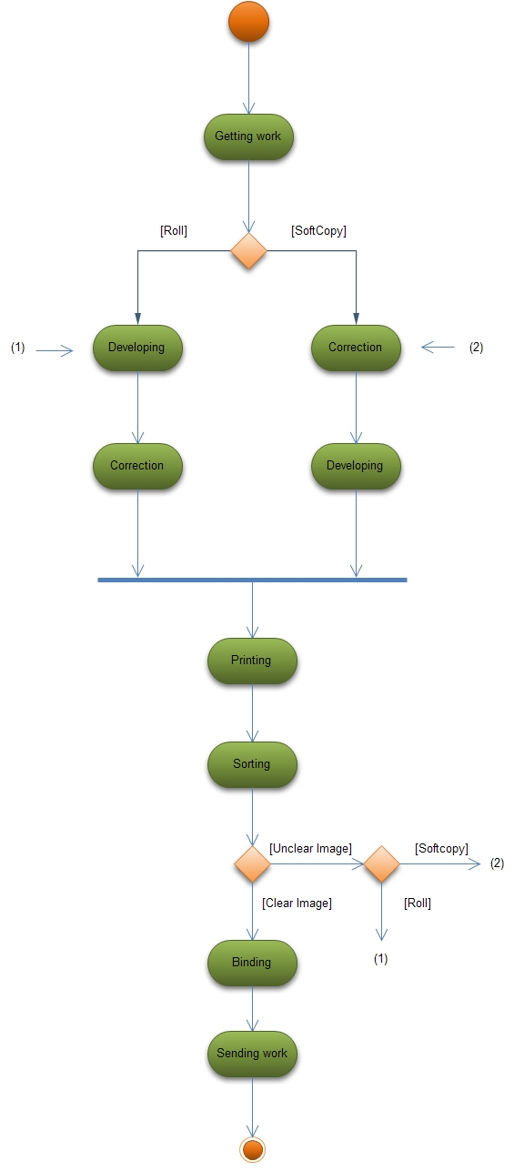
Activity Diagram – Developing and Printing Department

Slide 21
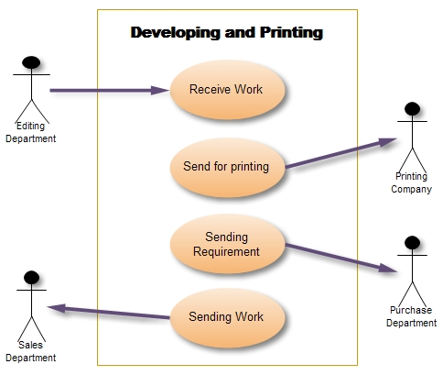
Use Case

Slide 22
Purchase Department
Maintain uninterrupted flow of materials to support the schedules.
Procure materials economically at a cost consistent with the quality and service required. However, generally all purchases may be attempted at the lowest cost.
Develop and maintain good buyer-seller relationship.
Sign contract with companies to get material at lowest price.
Maintain reputation and credibility in the market by fair dealings and payments.

Slide 23
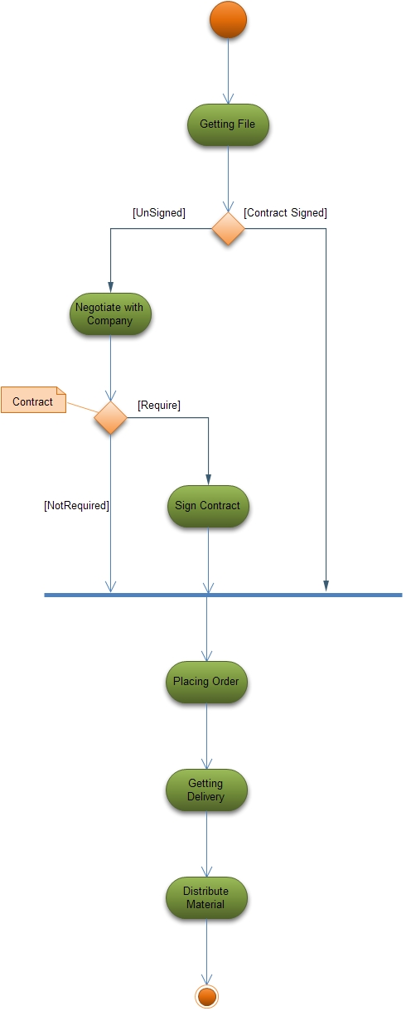
Activity Department - Purchase Department

Slide 24
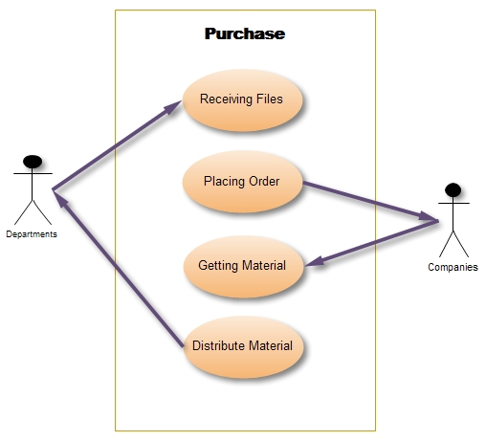
Use Case

Slide 25
Account Department
Handle general accounts
Prepare financial reports
Pay tax according to governments rules
Pay salary to staff

Slide 26
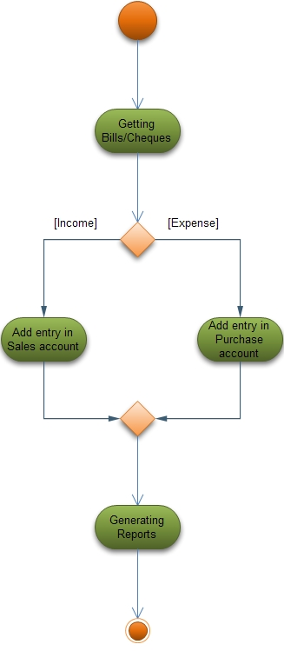
Activity Diagram - Account Department

Slide 27
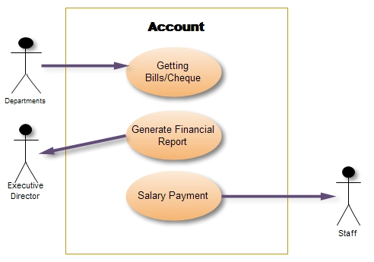
Use case

Slide 28
Thank You

